Slide 1
Automation Strategy Document
MOVIE RENTAL SERVICE
Prepared by: Hugs For Bugs Team
-Puneeta Mishra
-Yogesh Sharma

Slide 2
Contents
Problem Statement Summary
Proposed Solution
Framework Flow
Tools used for Automation
CI/CD Perspective

Slide 3

Problem Statement Summary
Problem Statement
There are two user types :
Normal user
Admin User
For the Normal user:
•Access the list of movies available, Search for the specific/available movies, Ability to login to the application, View details of the movies available and book them for rentals
for the Admin:
For the Admin user:
•information about the movies rented by a user till date, Rent a new movie if available, Cancel reservation for a new movie, Add or edit user reviews about a movie, Cancel reservation for a movie
• Ability to logout from the application

Slide 4


Proposed Solution
Let’s Automate to
reduce time
reduce effort
increase productivity
increase reliability
automated reporting
Proposed Automation Solution
As the URL has changed for the second release so we have implemented URL Provider class to handle it and code reusability can be implemented.
Can be implemented with Jenkins with CI/CD
Made the framework platform and browser independent

Slide 5
Framework Flow
Extent Report
(HTML)
TestNG.XML
TestNG
Automated Test Scripts
(Module wise)
Page Objects
Repository
Selenium WebDriver
AUT
Pom.XML
Maven
GENERIC FUNCTIONS
Xls_Reader
Apache POI
Test Cases +
Test Data
Environment Variables

Slide 6
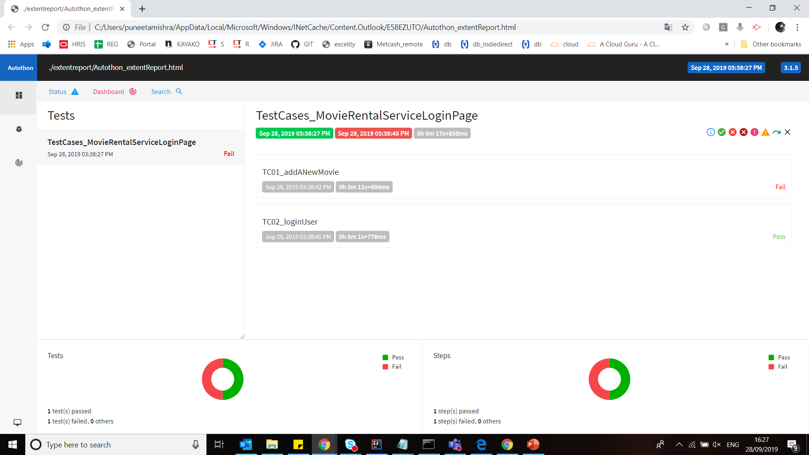
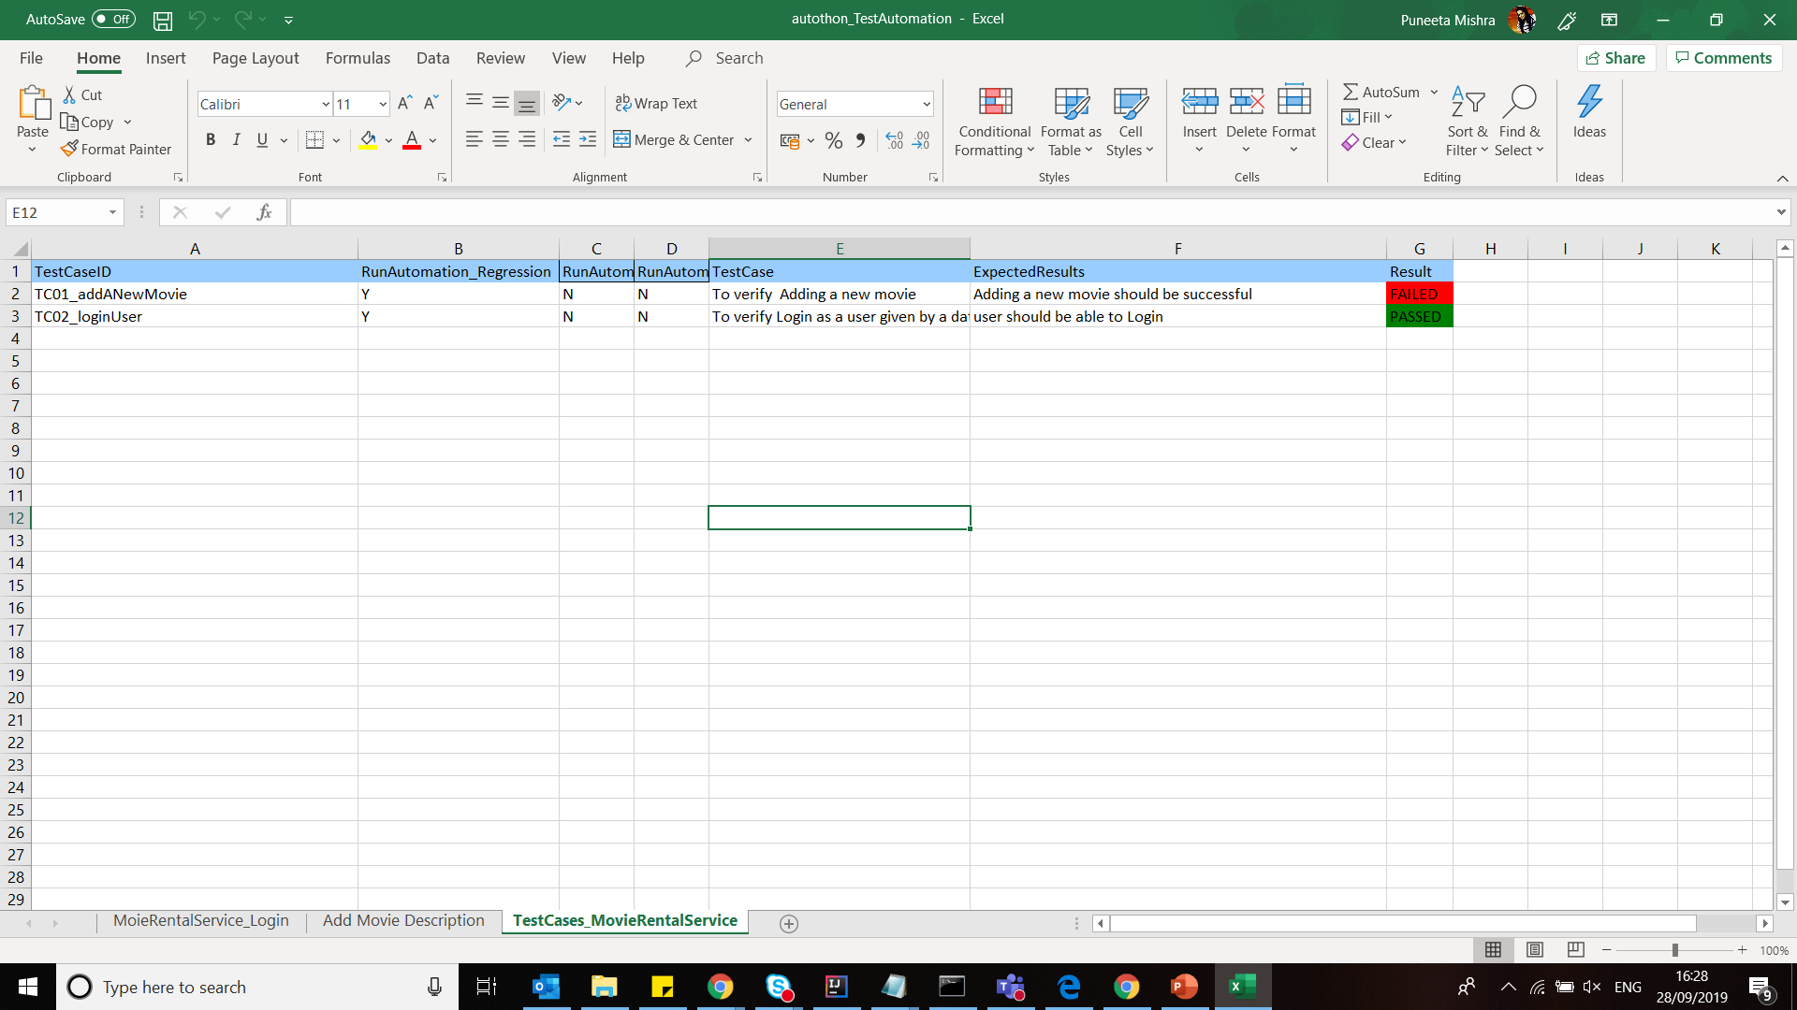
HTML AND EXCEL REPORTING with ARCHIVING

Slide 7
Tools been used
Selenium(Java API)
JAVA (Scripting Language)
Maven (Build Management Tool)
TestNG (Test Management Tool)
Git Integration (Code Repository)
Jenkins Integration (Automation server to build, deploy, test the software)
Extent Reports (Reporting Tool)

Slide 8
CI/CD perspective
Extent Report(HTML Report)
Excel reporting
Logging (Each step details)
Could be run on multiple and different platforms (i.e. local, dev, AWS, Staging)
CICD ( Ready to be the part of CICD)
Could be used for Regression/Sanity/Smoke testing suites
Test management: Environment Independent(Different Browser, Environment and Suites can be generated)

Slide 9
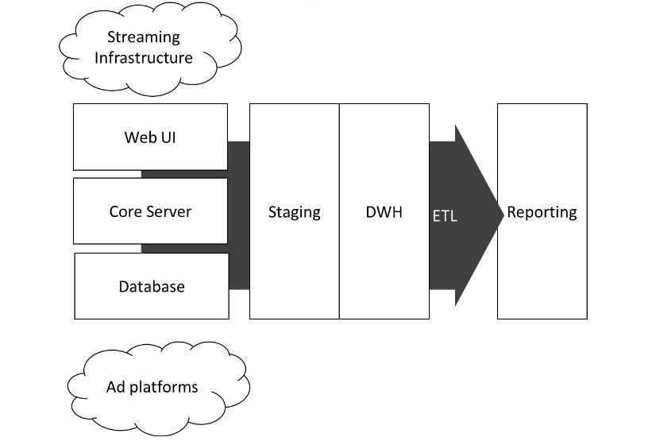
DWH/Payment/Streaming Content
DWH will collect/gather the data from all the different platforms like the rental application, the payment system, streaming infrastructure as well as various other sources.
This will be loaded into a DWH using ETL jobs and collect data to evaluate KPIs for external data sources.

Slide 10
Thank You!!!

